Slide 1
HAWASSA MESOB
Integrated Governance & Service Coordination Platform
PREPARED FOR EXECUTIVE CABINET

Slide 2


THIS IS A GOVERNANCE DECISION
APPROVAL CONCERNS
NOT AN IT PURCHASE
■
Institutional coordination
This initiative is focused on structural governance and workflow orchestration, not standard hardware procurement.
■
Revenue protection
■
Accountability enforcement
■
Administrative modernization

Slide 3

THE STRUCTURAL PROBLEM
This is a coordination deficit — not a staffing deficit.
CURRENT REALITY
FUTURE STATE
■
Fragmented bureau workflows
■
Coordinated operations
■
Manual verification gaps
■
Structured data integration
■
Limited SLA visibility
■
Visible SLA enforcement
■
High citizen navigation burden
■
Centralized citizen intake

Slide 4




WHAT MESOB FIXES
INSTITUTIONAL LEVEL
OPERATIONAL LEVEL
FINANCIAL LEVEL
Establishing structured, transparent inter-bureau coordination and defined mandates.
Orchestrating workflows to remove manual bottlenecks and redundant processing steps.
Ensuring complete transaction traceability and comprehensive revenue protection.

Slide 5
WHY NOW: THE URGENT IMPERATIVE
Delay increases structural strain.
Growing Urban Demand: Population scale requires automated response mechanisms.
Increasing Workflow Complexity: Manual routing can no longer sustain service volume.
Maturing National Standards: Digital frameworks demand immediate regional alignment.
Rising Citizen Expectation: Demand for transparent, rapid civic interaction.

Slide 6
WHY WE STUDIED THE REGIONAL MODEL
To evaluate real operational performance, integration challenges, institutional resistance, and sustainability risks.
We studied execution — not presentations.

Slide 7
WHAT THEY ACHIEVED
Acceleration is feasible under mandate.
70+
17
SERVICES ACTIVATED
BUREAUS INTEGRATED
■
Centralized citizen intake
Overcoming initial siloed operations.
■
Structured queue management
■
API-based coordination

Slide 8
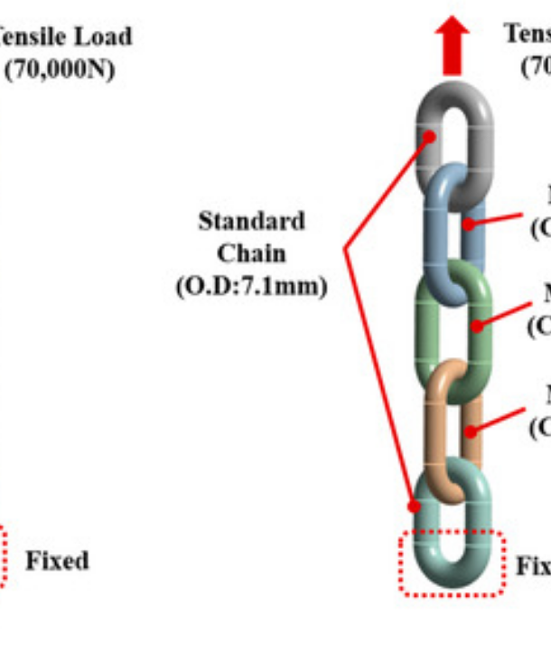
VULNERABILITIES OBSERVED
Lesson: Speed without structure creates fragility.
Partial bureau participation
Incomplete integrations
Dependency risks
Redundancy gaps
Governance enforcement strain

Slide 9


HAWASSA’S ADJUSTMENT
We refine — not replicate.
THE REGIONAL FLAW
THE HAWASSA MODEL
Attempting immediate total integration leading to systemic bottlenecks, lack of accountability, and weak inter-agency enforcement.
■
Phase integration strictly
■
Enforce bureau accountability
■
Validate redundancy before launch
■
Institutionalize governance first

Slide 10




WORK ALREADY COMPLETED
The foundational groundwork exists.
ANALYSIS
STRUCTURE
VALIDATION
•
Service cluster identification
•
Bureau readiness classification
•
Physical facility review
•
Benchmarking study execution
•
Governance draft structure
•
Vendor landscape scan

Slide 11
BUREAU READINESS MODEL
Expansion follows readiness — not pressure.
Level | Status | Integration Path
A | API-ready systems active | Direct connection / Immediate routing
B | Digital processes, no native API | Middleware adaptation layer required
C | Non-digital / Manual workflows | Phased onboarding and digitization first

Slide 12


INFRASTRUCTURE PHILOSOPHY
LOGIC-DRIVEN SCALING
1. Service Volume
2. Workflow Load
3. Infrastructure Sizing
Not hardware-first planning.

Slide 13
GOVERNANCE STRUCTURE DRAFTED
Institutional clarity precedes launch.
Steering Committee: Executive oversight and strategic mandate enforcement.
MESOB Director: Singular operational authority and vendor coordination.
Technical Working Group: Architecture validation and systems integration.
Bureau Focal Network: Embedded champions driving departmental adoption.
Compliance Monitoring: SLA tracking and continuous performance auditing.

Slide 14
PHASED EXPANSION LOGIC
We will not integrate 20 bureaus at once.
Phasing protects stability.

Slide 15
TARGET: MONTH 2
■
5–7 Bureaus engaged
Pilot
■
15–25 Services live
■
SLA Dashboard active
VALIDATION STAGE
■
Governance fully operational

Slide 16
TARGET: MONTH 6
■
10–15 Bureaus onboarded
Scale
■
50–70 Services active
■
Middleware activated
STABILIZED EXPANSION
■
Performance Monitoring normalized

Slide 17
TARGET: YEAR 1
■
15–20 Bureaus fully integrated
Core
■
80–120 Services operational
■
Revenue Tracking centralized
SUSTAINABLE INTEGRATION
■
Institutional Backbone established

Slide 18


WHAT ACCELERATES VS DELAYS
Speed depends on discipline.
ACCELERATORS
DELAYS
■
Clear executive directive
■
Internal bureau resistance
■
API operational readiness
■
Undefined service parameters
■
Strictly defined workflows
■
Digital infrastructure immaturity

Slide 19
ENFORCEMENT MECHANISM
Passive resistance will not stall progress.
Formal Participation Directive: Mandatory adoption framework from the cabinet.
Integration Deadlines: Hard timelines enforced per bureau phase.
Weekly Dashboard Review: Executive visibility into bureau compliance and SLA adherence.
Escalation Authority: Pre-defined protocols for bypassing operational roadblocks.

Slide 20
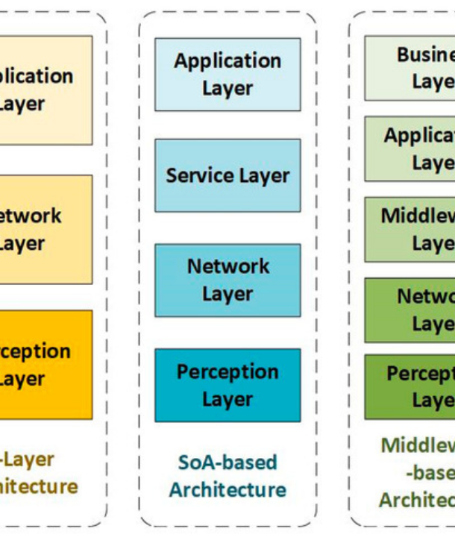
ARCHITECTURE OVERVIEW
Each layer supports the next.
Citizen Interaction: Portals and access points.
Application & Workflow: Business logic.
Integration Gateway: API management.
Infrastructure Backbone: Compute and storage.

Slide 21



SECURITY & REDUNDANCY
Security is systemic — not a single device.
ACCESS CONTROL
PERIMETER PROTECTION
CONTINUITY
Automated data replication and uninterruptible backup power infrastructure.
Role-based access control (RBAC) ensuring strict data segregation and operational authorization.
Comprehensive network segmentation and continuous perimeter threat monitoring.

Slide 22
INFRASTRUCTURE DELIVERY CONTEXT
Final selection follows scope approval.
Tier Level | Capability Scope | Benchmarking Verdict
Basic | Standard connectivity and shared resources. | Insufficient for scaled service orchestration.
Standard | Dedicated resources, limited redundancy. | Acceptable for pilot, risky for full integration.
Platinum | High availability, automated failover, strict SLAs. | Favored for long-term regional stability.

Slide 23




FUTURE-PROOF DESIGN
Designed for continuous evolution.
DIGITAL ID READY
HYBRID ACCESS
SCALABLE CORE
Native architecture support for upcoming national digital identification frameworks.
Seamless transition capability towards full online submission, reducing physical dependency.
Elastic infrastructure designed to handle exponential transaction volume growth.

Slide 24
FINANCIAL DISCIPLINE
Budget follows structure.
Phased Commitment: Funding released exclusively tied to integration milestones.
Milestone-Based Release: Proof of operational capability required for next-tier funding.
SLA-Linked Accountability: Vendor payments strictly tethered to performance metrics.
No Open-Ended Contracts: Absolute prohibition on undefined delivery timelines.

Slide 25


SOFTWARE & STANDARDS GOVERNANCE
NATIONAL AUTHORITIES PROVIDE
CITY RETAINS CONTROL OVER
■
Integration standards
■
Implementation pacing
■
Compliance verification
■
Vendor accountability
■
Baseline security guidance
■
Operational management

Slide 26
VENDOR ENGAGEMENT MODEL
No premature commitment.
Scope Freeze: Absolute definition of requirements before vendor dialogue.
Technical Specification: Detailed architectural prerequisites mapped.
Structured Engagement: Formalized RFP and vendor capability assessment.
SLA Negotiation: Hard-coding performance penalties and uptime requirements.
Phased Deployment: Vendor delivery segmented by pilot, scale, and core phases.

Slide 27
90-DAY EXECUTION: DAYS 1–30
Authority First.
■
Governance activation
30
■
Bureau focal appointment
■
Service definition workshops
DAYS
■
Project scope freeze

Slide 28
90-DAY EXECUTION: DAYS 30–60
Stability Before Launch.
■
Infrastructure preparation
60
■
Integration configuration
■
Redundancy validation
DAYS
■
Intensive testing cycles

Slide 29
DAY 90 POSITION
Expansion decision will be evidence-based.
■
5–7 bureaus live
90
■
15–25 services operational
■
SLA Dashboard active
DAYS
■
Structured performance report submitted

Slide 30


CABINET AUTHORIZATION REQUIRED
Approval Authorizes:
Governance activation
Bureau participation directive
90-day pilot launch
Structured vendor engagement
Phased financial commitment
This is not an IT project. It is a governance backbone.

Slide 31




IMAGE SOURCES
https://www.mdpi.com/applsci/applsci-15-07841/article_deploy/html/images/applsci-15-07841-g012-550.jpg
Source: www.mdpi.com
https://images.squarespace-cdn.com/content/v1/6284780465d33b5496b68ad2/2bbfd32a-9f50-46ce-a3cb-1835714ade88/Data+Centers.jpeg
Source: normanwright.com
https://www.mdpi.com/information/information-12-00087/article_deploy/html/images/information-12-00087-g001-550.jpg
Source: www.mdpi.com
https://fargowoodworks.com/wp-content/uploads/2025/04/openart-image_6jBe-DtG_1741203830176_raw.jpg
Source: fargowoodworks.com

